Slide 1


Renton Fish and Game Club
USPSA
August 2021
Match Booklet

Slide 2
Stage 1 Pickup Sticks Course Designer: Jordan Rogers
Pickup Sticks is a 27 round, 135 point Comstock Long Course. There are 11 metric targets and 5 steel targets. The best two hits per target will score. Steel must fall to score. The start signal is audible.
The start position is standing anywhere completely outside the shooting area, heels touching any fault line. Handgun is loaded and holstered. PCC is loaded, stock on belt, muzzle pointing down range.
On the audible start signal, engage all targets from within the shooting area. The walls constructing the Cooper Tunnel extend to infinity. See rule 2.2.3.4. Per 10.2.5, a competitor who disturbs one or more piece of the overhead material in the Cooper Tunnel will receive one procedural penalty for each piece which falls during the course of fire. Overhead material which falls as a result of the competitor bumping or striking the uprights, or as a result of muzzle gases or recoil, will not be penalized. All barrels are soft cover.

Slide 3
 | Renton Fish and Game Bay 1 Pickup Sticks Course Designer: Jordan Rogers

Slide 4
Stage 2 Into The Icebath Course Designer: Marcel Englmaier
Into The Icebath is an 11 round, 55 point Comstock Medium course. There are 4 metric targets and 3 steel targets. The best two hits per target will score. Steel must fall to score. The start signal is audible.
The Handgun start position is heels touching marks with wrists below belt. Handgun is loaded and holstered. The PCC start position is heels touching marks. PCC loaded with stock touching belt, muzzle pointing downrange, and both hands on PCC.
On the audible start signal, engage all targets from within the shooting area.

Slide 5
 | Renton Fish and Game Bay 2 Into The Icebath Course Designer: Marcel Englmaier
X
X

Slide 6
Stage 3 Black Tie Event Course Designer: Eric Beerbaum
Black Tie Event is a 28 round, 140 point Comstock long course. There are 14 metric targets. The best two hits per target will score. The start signal is audible.
The Handgun start position is handgun loaded and holstered, heels on Xs, wrists below belt. The PCC start position is PCC loaded, heels on Xs, stock touching belt, muzzle pointed downrange.
On the audible start signal, engage all targets from within the shooting area.

Slide 7
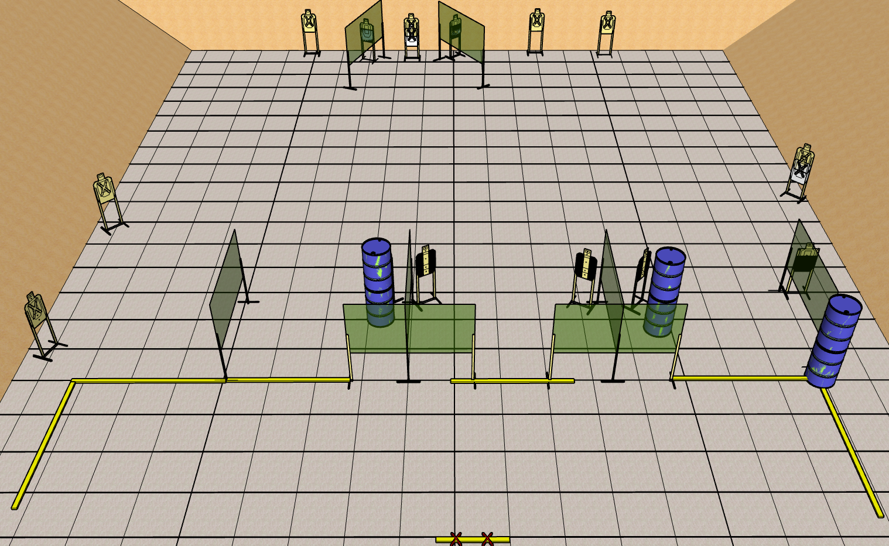
 | Renton Fish and Game Bay 3 Black Tie Event Course Designer: Eric Beerbaum

Slide 8
Stage 4 It’s You Call Course Designer: Chris Pukalo
It’s Your Call is a 26 round, 130 point Comstock Long course. There are 12 metric targets and 2 steel targets. The best two hits per target will score. Steel must fall to score. The start signal is audible.
The Handgun start position is standing inside the shooting area with toes touching marks. Handgun is loaded and holstered with wrist below top of belt. The PCC start position is standing inside the shooting area with toes touching marks. PCC is loaded with stock touching belt, muzzle pointed downrange.
On the audible start signal, engage all targets from within the shooting area.

Slide 9
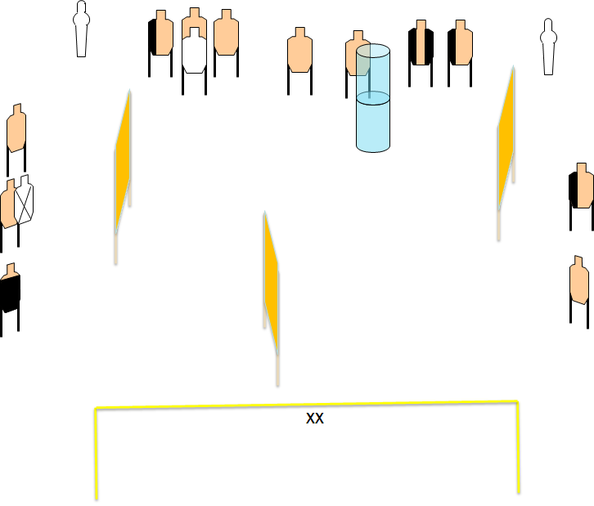
 | Renton Fish and Game Bay 4 It’s Your Call Course Designer: Chris Pukalo

Slide 10
Stage 5 Hilarity Ensues Course Designer: Eric Beerbaum
Hilarity Ensues is a 12 round, 60 point Virginia count short course. There are 12 metric targets. The best one hit per target will score. The start signal is audible.
The Handgun start position is loaded and holstered with one hand on each of the upper Xs. The PCC start position is loaded, stock on belt, muzzle touching lower X.
On the audible start signal, engage all targets from within the shooting area.

Slide 11
 | Renton Fish and Game Bay 5 Hilarity Ensues Course Designer: Eric Beerbaum
Tree Box
X X
X

Slide 12
Stage 6 Well, Technically Course Designer: Jordan Rogers
Well, Technically is an 18 round, 90 point, Virginia Count Standards Exercise. There are 6 metric targets. The best three hits per target will score.
String 1 start position: Standing completely outside the left OR right side of the shooting area, facing downrange. Handgun is loaded and holstered. PCC is loaded with stock on belt, muzzle pointed down range. String 2 start position: Standing completely outside the shooting area on the same side as string 1, facing downrange. Handgun is loaded and holstered. PCC is loaded with stock on belt, muzzle pointed down range.
String 1: On the start signal, engage each target with one round each, perform a mandatory reload and engage each target with one round each, strong hand only. String 2: On the start signal, engage each target with one round each, weak hand only.

Slide 13
 | Renton Fish and Game Bay 6 Well, Technically Course Designer: Jordan Rogers
Notes:
Box should be narrow, ~2.5’, Narrow enough to require footwork but not so narrow it is a huge tripping hazard

Slide 14
Stage 7 Kilroy Was Here Course Designer: Eric Beerbaum
Kilroy Was Here is a 24 round, 120 point Comstock long course. There are 12 metric targets. The best two hits per target will score. The start signal is audible.
The Handgun start position is standing outside shooting area with toes touching marks and wrists below belt. Handgun loaded and holstered. The PCC start position is standing outside shooting area with toes touching marks. PCC loaded with stock touching belt and muzzle pointed down range.
On the audible start signal, engage all targets from within the shooting area.

Slide 15
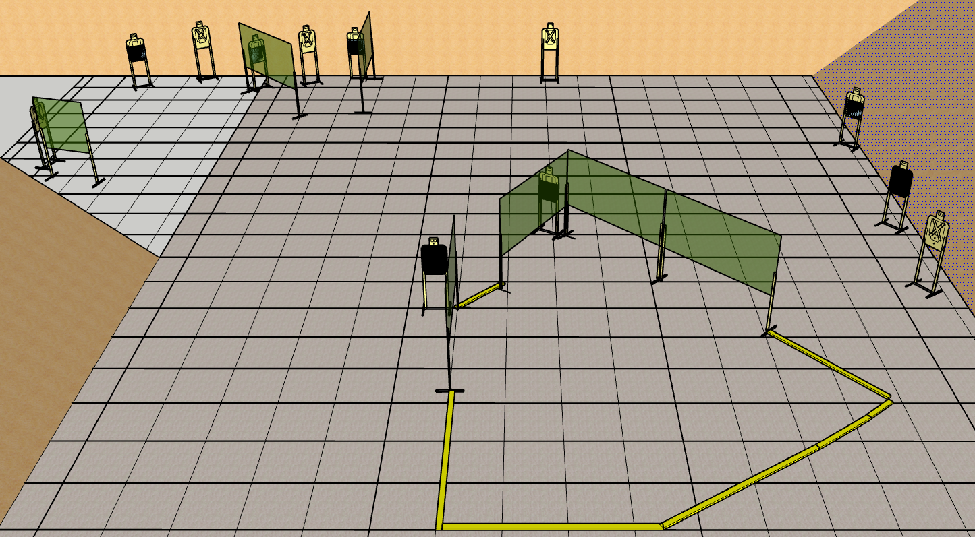
 | Renton Fish and Game Bay 7 Kilroy Was Here Course Designer: Eric Beerbaum

